Slide 1
CLINIC MANAGEMENT SYSTEM
-
User Manual
-
2022

Slide 2
Table of Contents
No | System modules | Page No.
1 | Log In screen | 2
2 | Home page | 3
3 | Patients | 4
4 | Medicines | 7
5 | Reports | 9
6 | Users | 11

Slide 3
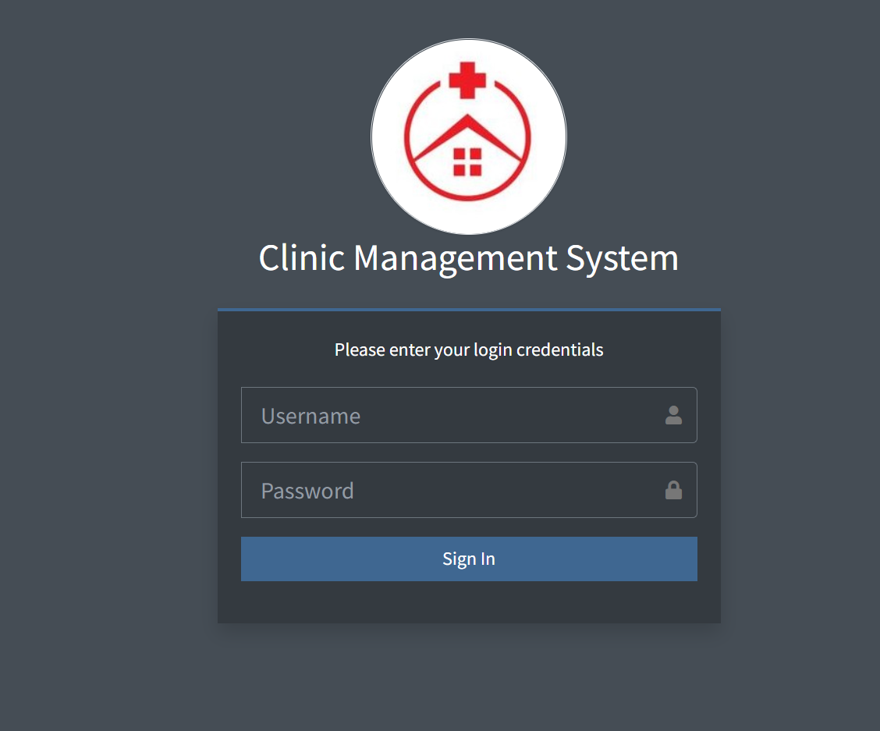
Log In Screen
This is the screen that the system displays when a admin/system user is logging into the system.
Enter your username that is registered on the system.
Enter your log in password.
Click on the Sign in button to be directed to the dashboard screen.

Slide 4
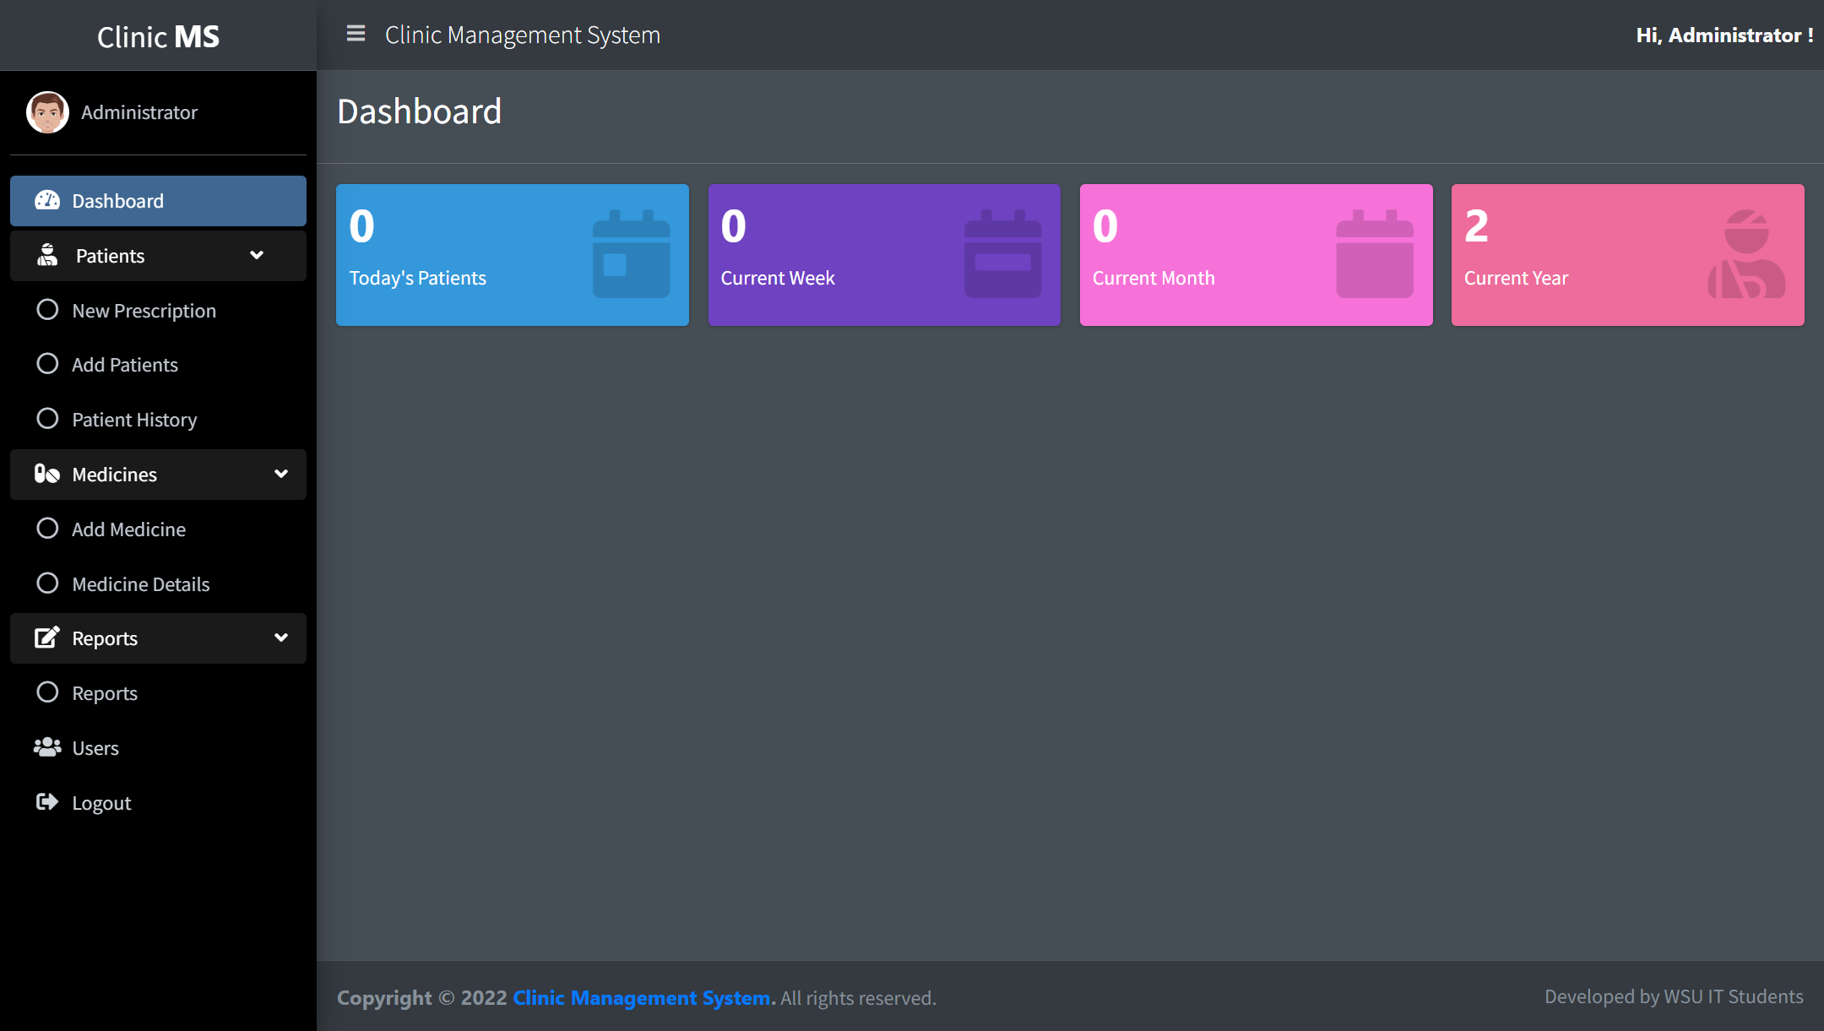
System home page
System name
Name of the logged in system user.
Patient visits statistics.
System menu items.

Slide 5
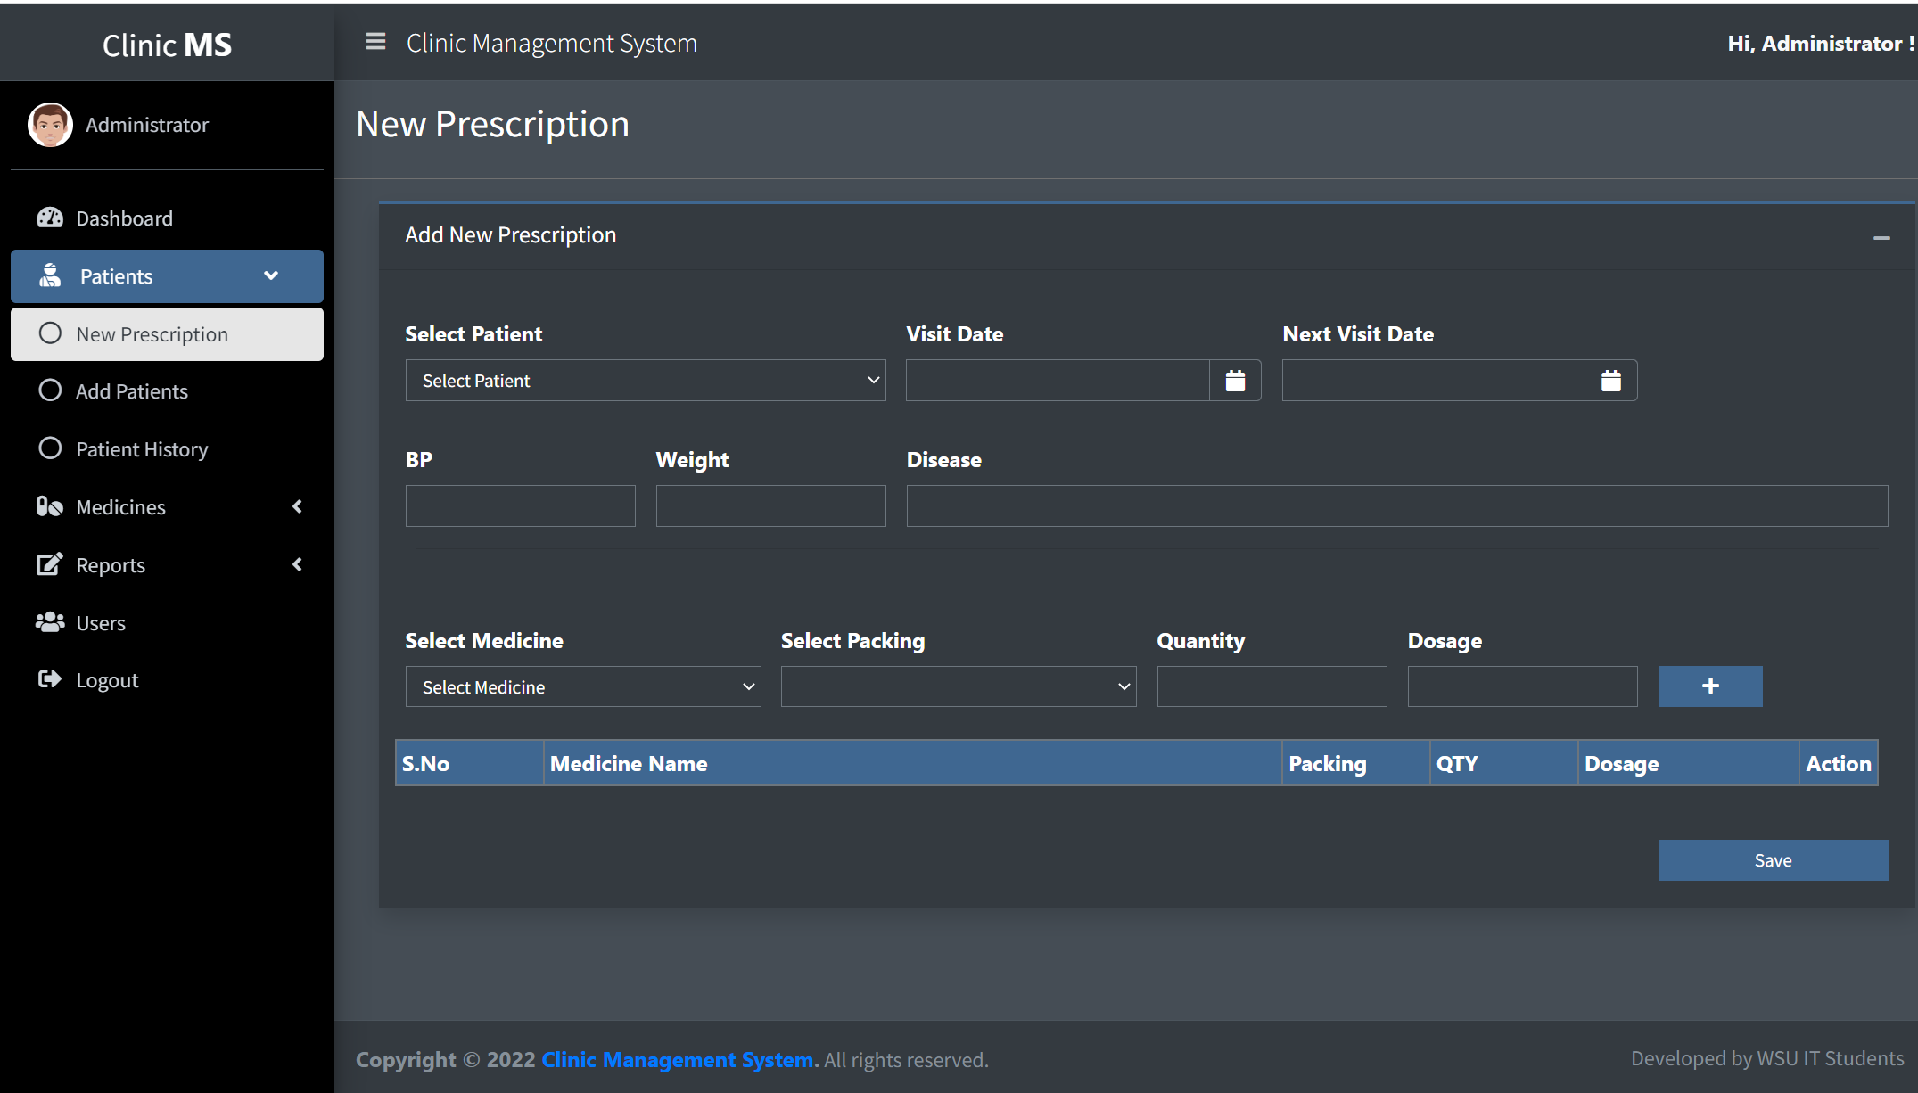
Patients| New Prescription
Select a patient then add prescription
Click plus button to add prescription
Table to show prescription for client

Slide 6
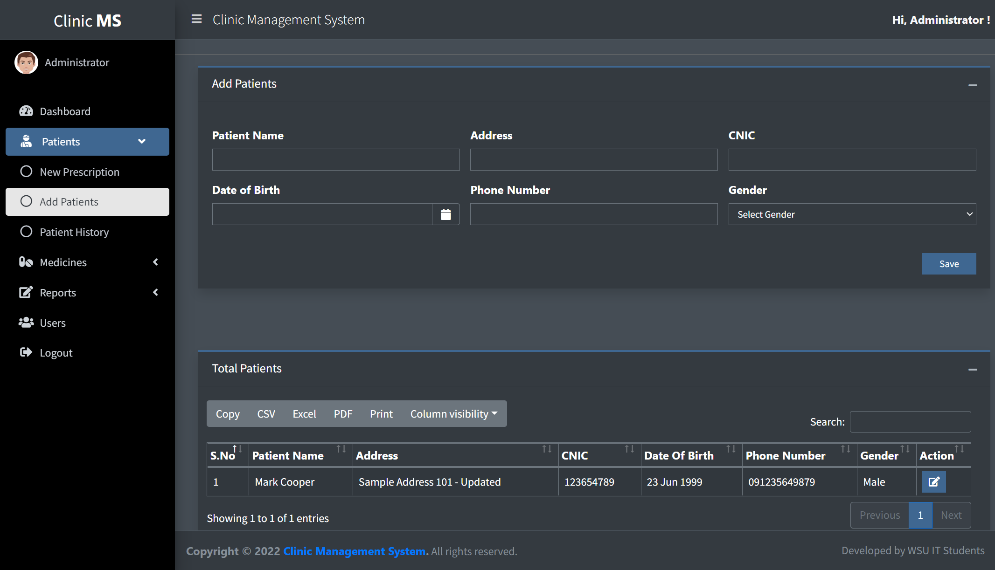
Patients| New Patient
Computerized Identity Card (ID. No.)
Form to capture new patient.
Click to save submitted patient details.
Click to export table format of your choice
Use the arrows to sort the table entries in ascending or descending order.
Use the search field to search for entries in the table.
Click to edit patient details.
Table showing patients that have been captured.
Click previous or next to navigate between pages.

Slide 7
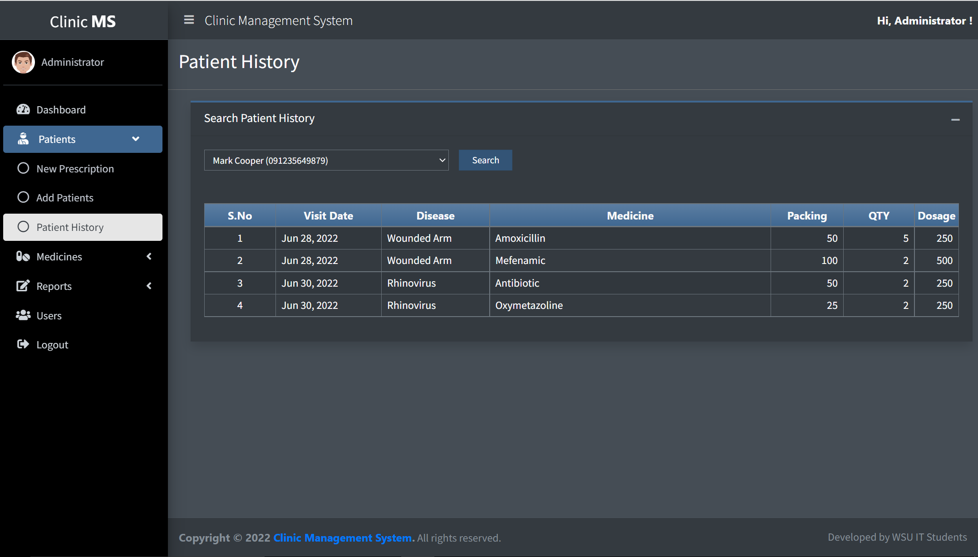
Patients| Patient History
Form to search for patient.
Click to search to search for patient history.
Table showing patient records.

Slide 8
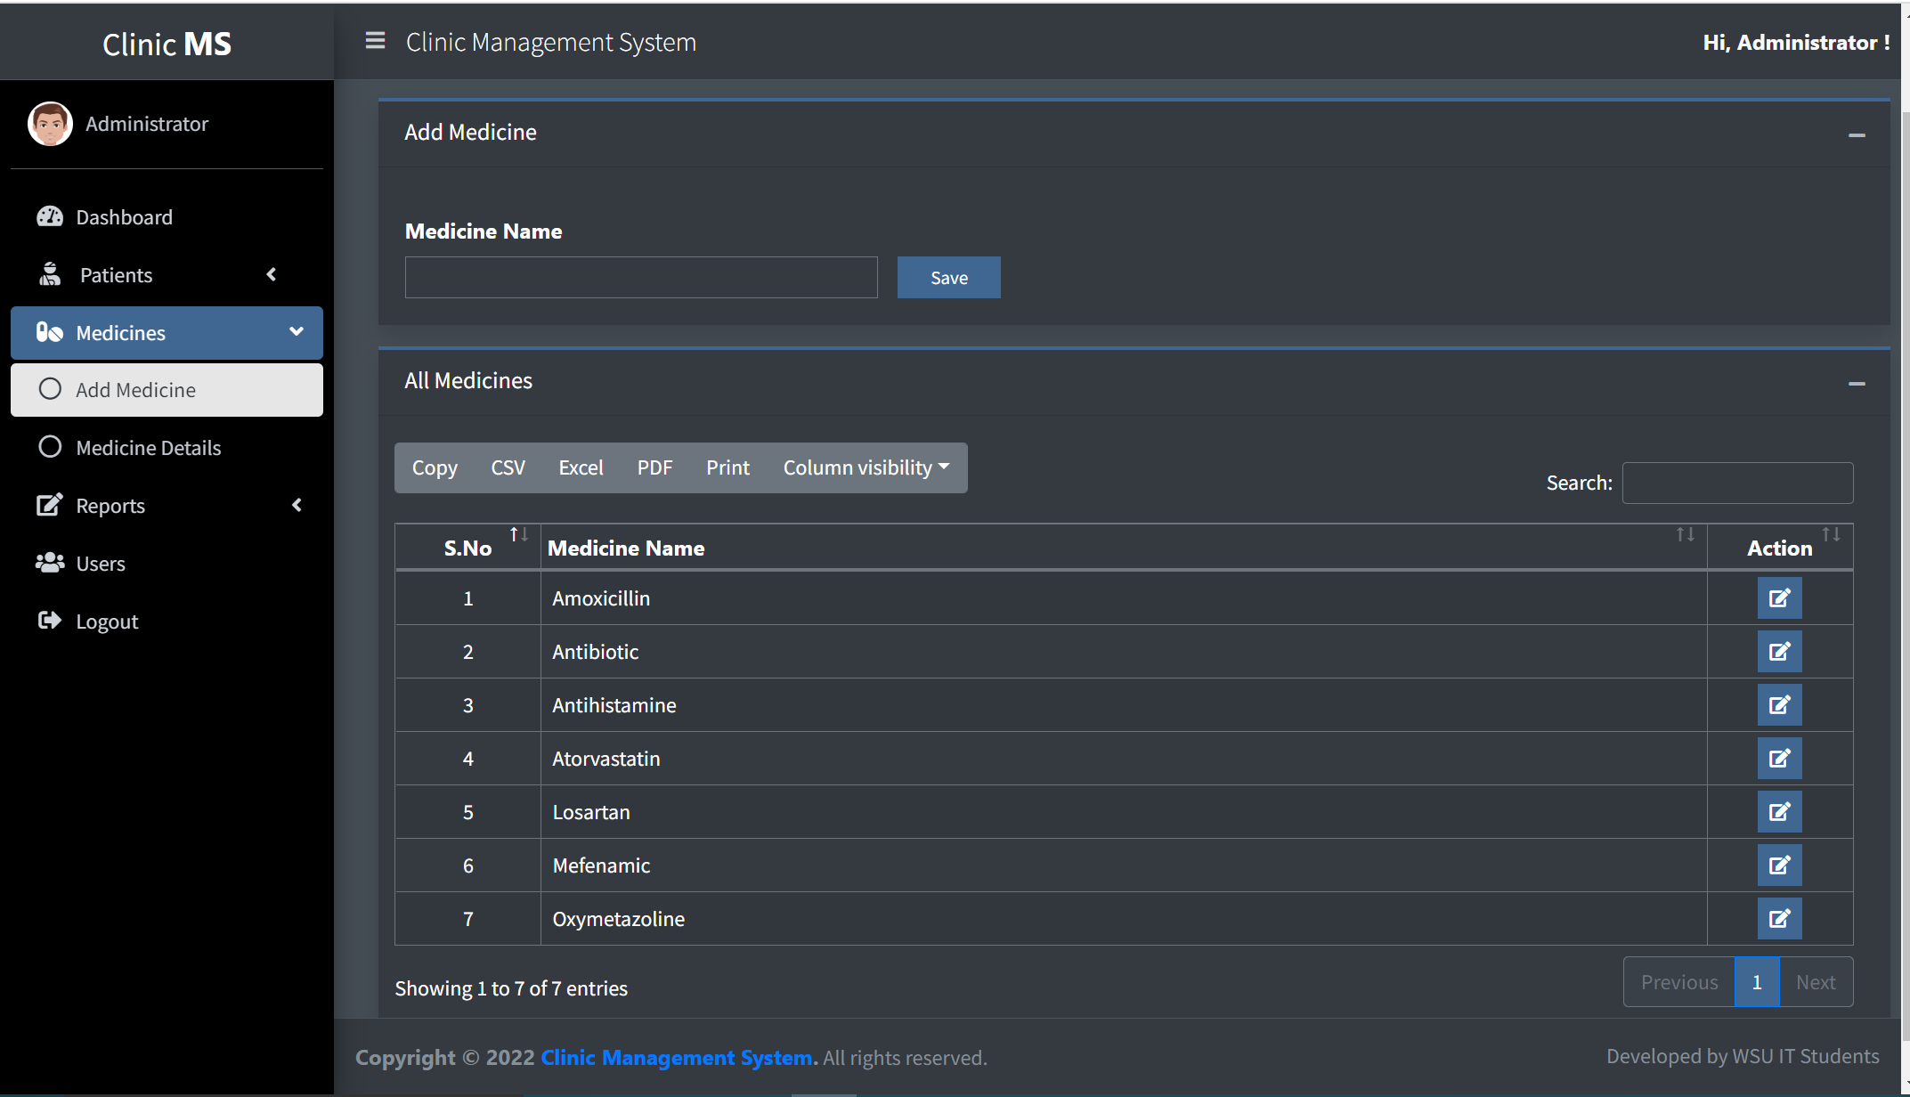
Medicines | Add Medicine
Form to capture new medicine.
Click to save submitted medicine.
Use the arrows to sort the table entries in ascending or descending order.
Click to export table format of your choice
Use the search field to search for entries in the table.
Click to edit medicine.
Table showing medicines that have been captured.
Click previous or next to navigate between pages.

Slide 9
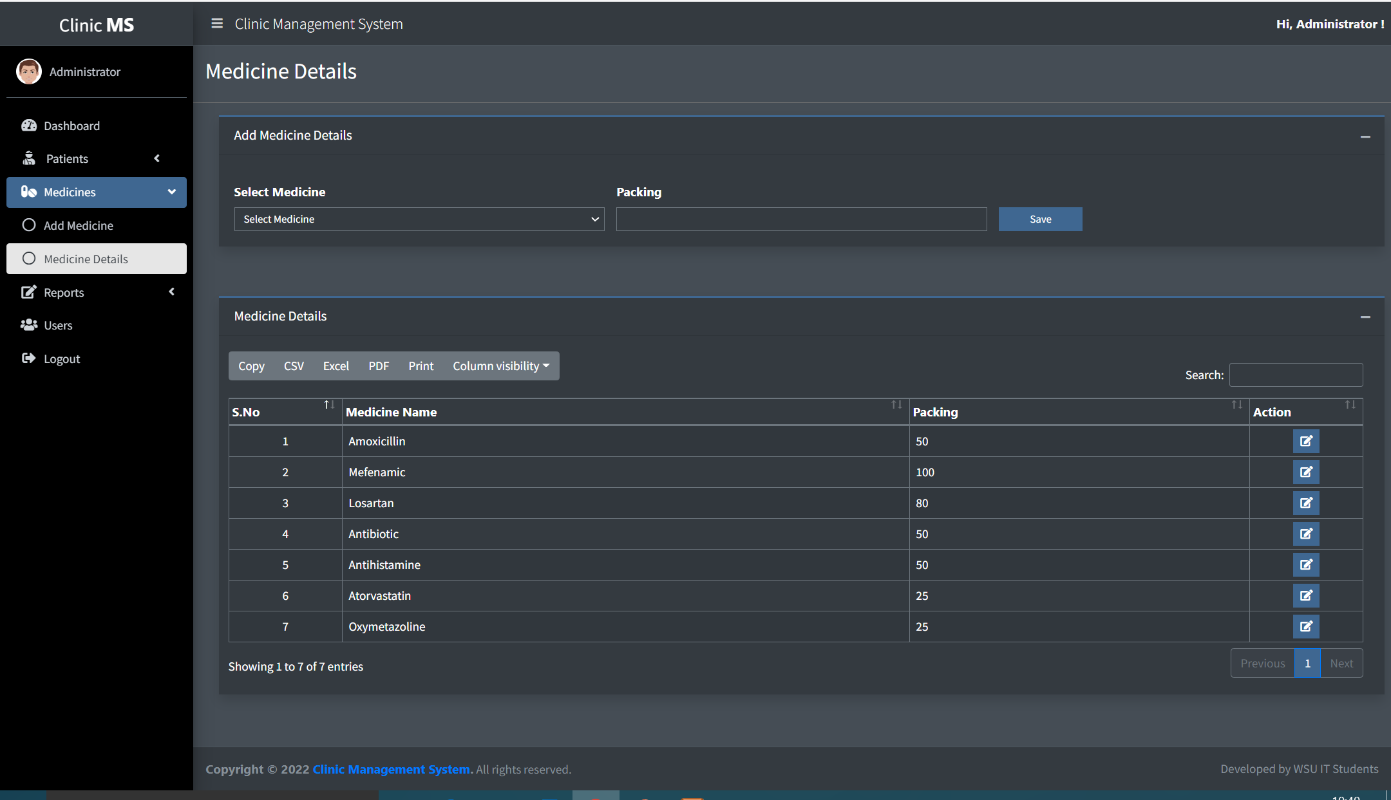
Medicines | Medicine Details
Form to capture new medicine details.
Click to save submitted medicine details.
Use the arrows to sort the table entries in ascending or descending order.
Click to export table format of your choice
Use the search field to search for entries in the table.
Click to edit medicine details.
Table showing medicines that have been captured.
Click previous or next to navigate between pages.

Slide 10
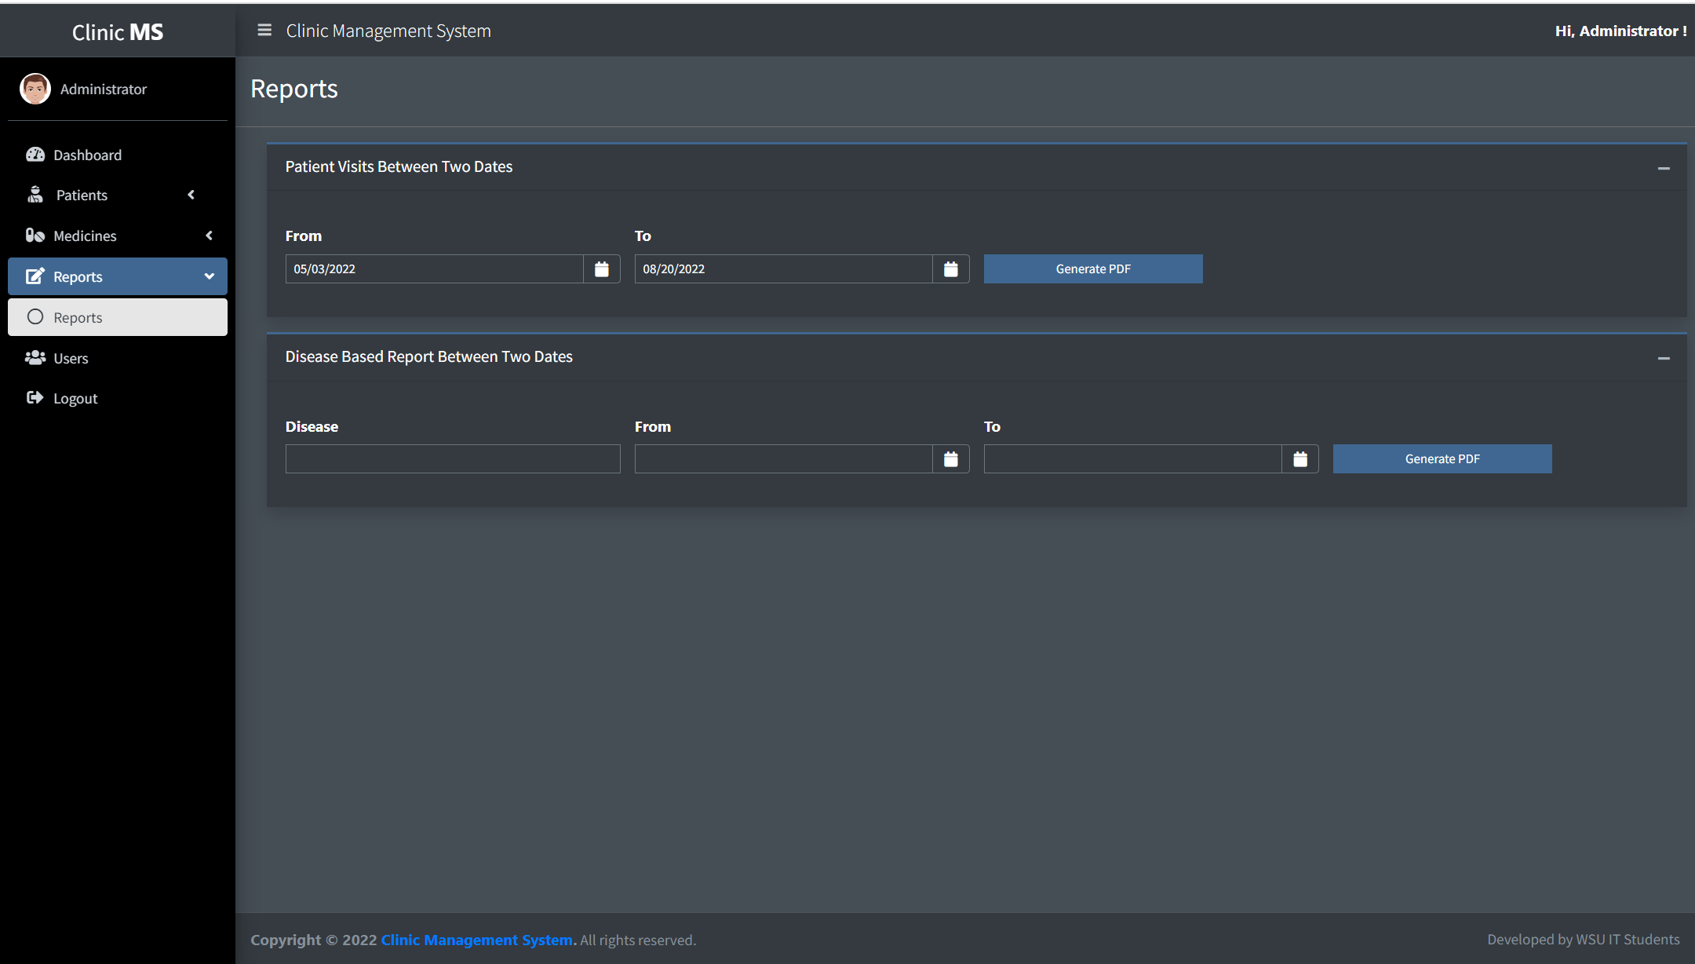
Reports
Form to generate report for patients visits between two dates
Click to generate PDF to print patients report.
Form to generate report for disease between two dates
Form to generate report for disease between two dates

Slide 11
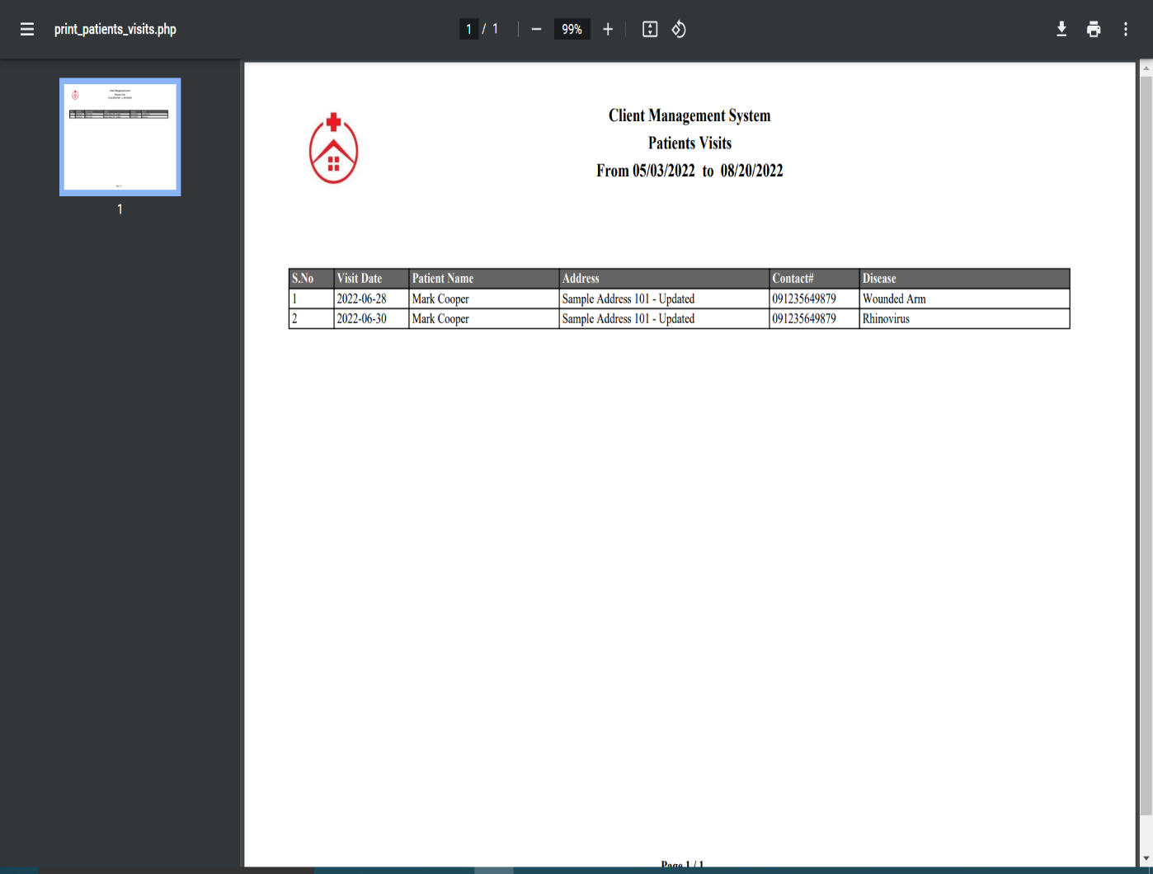
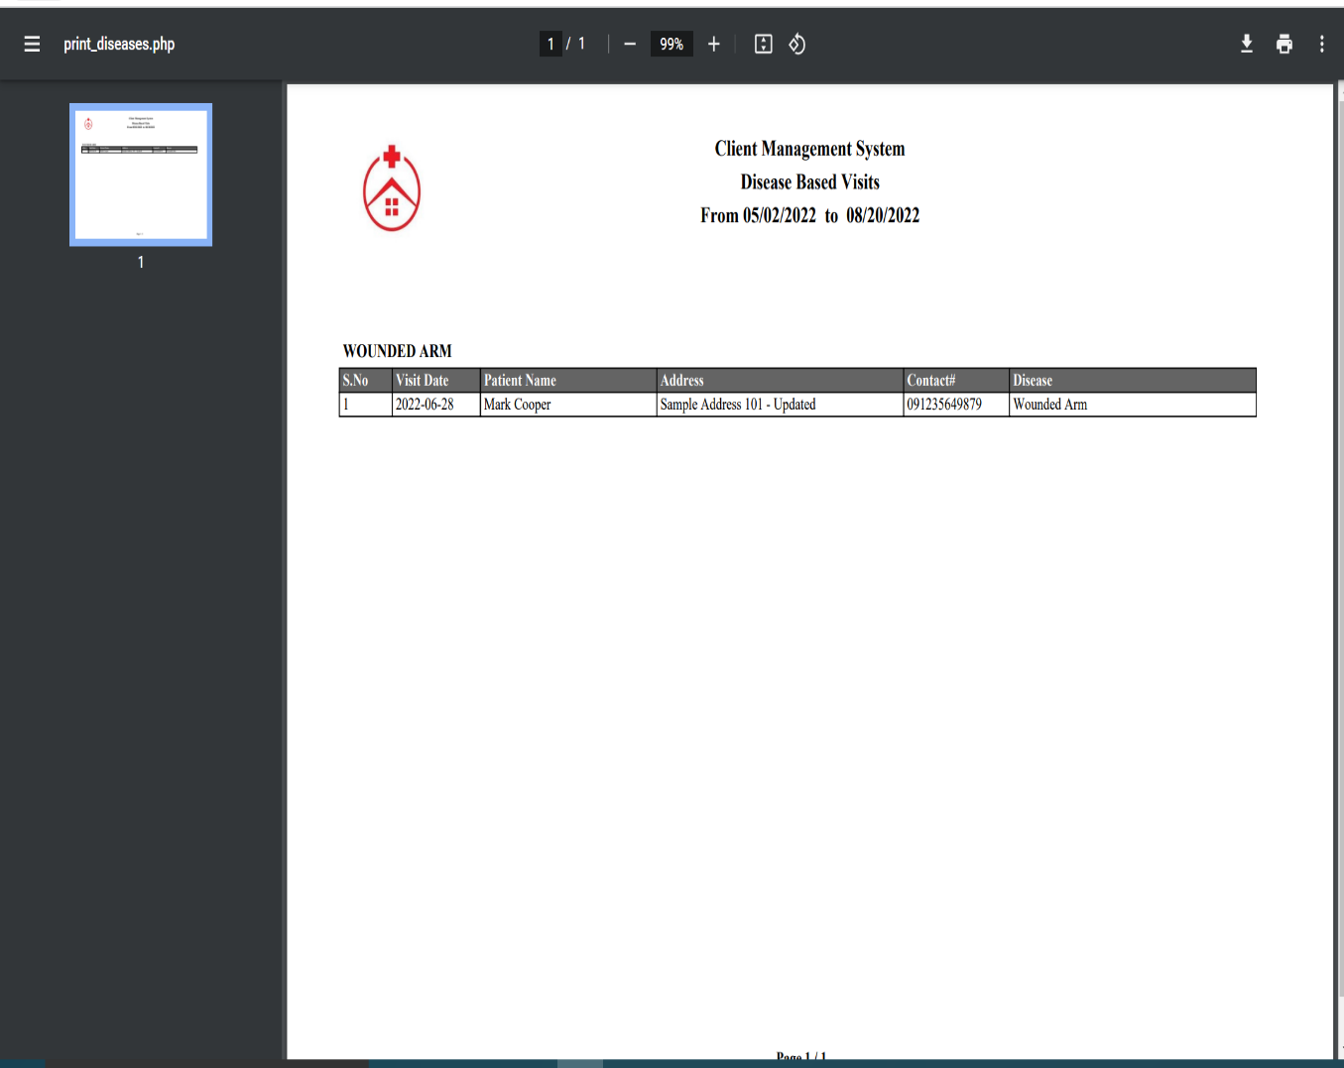
Reports | results
Disease Report Results
Patient Report Results

Slide 12
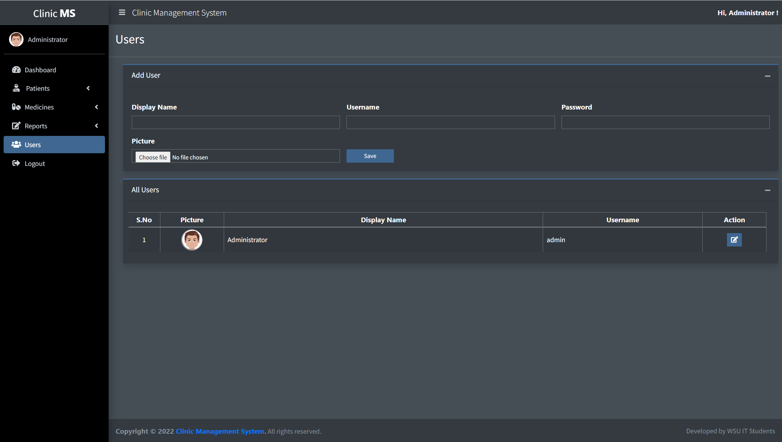
Users
Form to capture new user of the system
Click to save to capture new user details.
Table that shows list of users in the system.
Click to edit user details.
Click to logout out to the system.

Slide 13
CLINIC MANAGEMENT SYSTEM
-
User Manual
-
2022
-
END

